Slide 1
Big Data Analytics PI (Program Increment Planning)
Define MMPs (Minimal Marketable Product)
Minimal Marketable Product describes the product with smallest feature set that address the user needs and creates the right user experience
Owner: Enterprise/Solution Architects and Delivery Lead working in collaboration with business stakeholders
Define Features required to meet MMPs, focus on features for upcoming PI
Features are improvement or capability of value to the stakeholder that can be developed in a release time box (PI increment)
Define a lifecycle/sequence for feature deliverables to meet MMPs
Identify impacted scrum teams, especially Big Data dependent teams
Engage impacted teams to review features, confirm team’s impact, and agreement to include features as candidates for next PI planning
Upon confirmation of team’s impact, define high level user stories for impacted teams
Owner: System Engineers working in collaboration with business stakeholders, and technical teams (Architects, Developers)

Slide 2
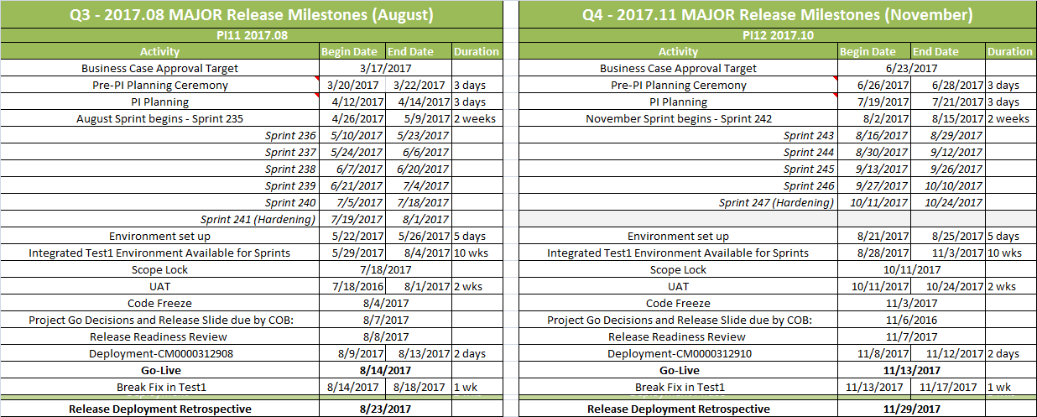
PDT 2017 Release Calendar
Pre-PI Planning for PI11: March 20 - 22
PI11 Planning: April 12 - 14
Release Calendar are located HERE

Slide 3
Timeline for BDA Use Cases in preparation for PI11
Complete by March 3
Enterprise/Solution Architects: Define MMPs and Features for ALL Use Cases in BDA
System Engineers: Define lifecycle/sequence for feature deliverables
March 6 – 17
Delivery Leads: Engage impacted teams to review features
March 24
Confirmation of BDA features will be candidates for PI11 planning
March 27 – April 7
Define detailed User Stories for candidate Features in PI11
Provide relative estimates (story points) for user stories
Owner: Big Data Dev Team

